Slide 1
Restaurant Order Management System
Presented By :
Kajal Mutkule (Dec 2023)
Rupali Mundhe (Dec 2023)

Slide 2
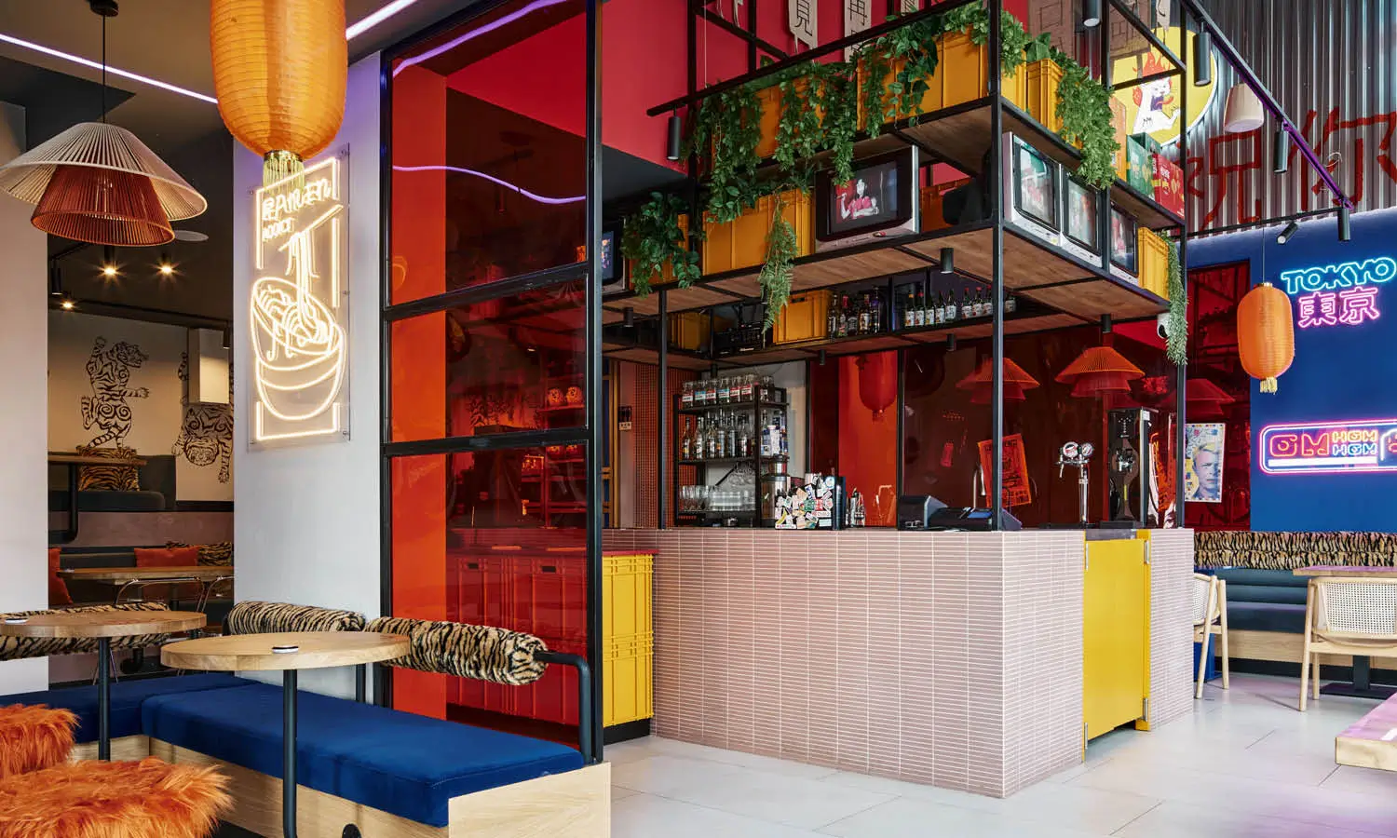
Table of contents
Summery
Work Flow
Requirements
ER Diagram
Database Design

Slide 3


SUMMERY
The Restaurant Order Management System is designed to streamline the ordering process for restaurants, improving efficiency and customer satisfaction. This system allows customers to place orders and restaurant staff to manage orders, inventory, and customer information.

Slide 4

WORK FLOW
Customer Registration: customers can register and create an account or login to an existing account.
Menu details : Customer can see availability of different type of dishes from menu.
Order Placement: customers can place orders online or through a mobile app.
Order Management: restaurant staff can manage orders, update order status, and assign orders to staff.
Customer Information Management: restaurant staff can manage customer information, including contact details and order history.
Payment Processing: the system integrates with payment processors to facilitate online payments as well as cash payments.
Bill Invoice Generation: Customer will get Total Bill generated with GST.

Slide 5
WORK FLOW DIAGRAM
Bill
Invoice
Payment
Payment Mode
Cash
Customer / Staff Registration
Register
Login
Menu
Veg
Non-Veg
Order
Quantity
Dish Name
Price

Slide 6
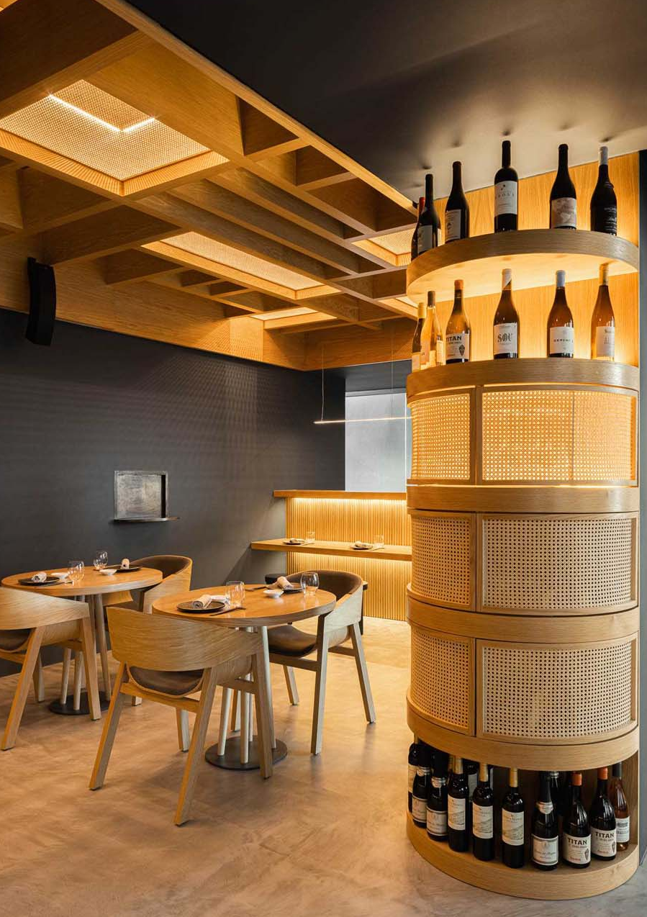
TECHNOLOGIES:
Backend: Java, JDBC .
Database: MySQL
Tools : Eclipse .

Slide 7
Restaurant order management system
Org.techhub.clientapp
Org.techhub.exception
Org.techhub.model
Org.techhub.repository
Org.techhub.service
RestaurantOrderMangementSystem.java
UserModel.java
StaffModel.java
CustomerModel.java
MenuModel.java
DBConfig.java
DBUser.java
CustomerRepositoy(Interface)
CustomerRepositoryImp.java
StaffRepository(Interface)
StaffRepositoryImp.java
MenuRepository(Interface)
MenuRepositoryImp.java
CustomerService(Interface)
CustomerServiceImp.java
StaffService(Interface)
StaffServiceImp.java
MenuService(Interface)
MenuServiceImp.java
Work Flow Of Project

Slide 8
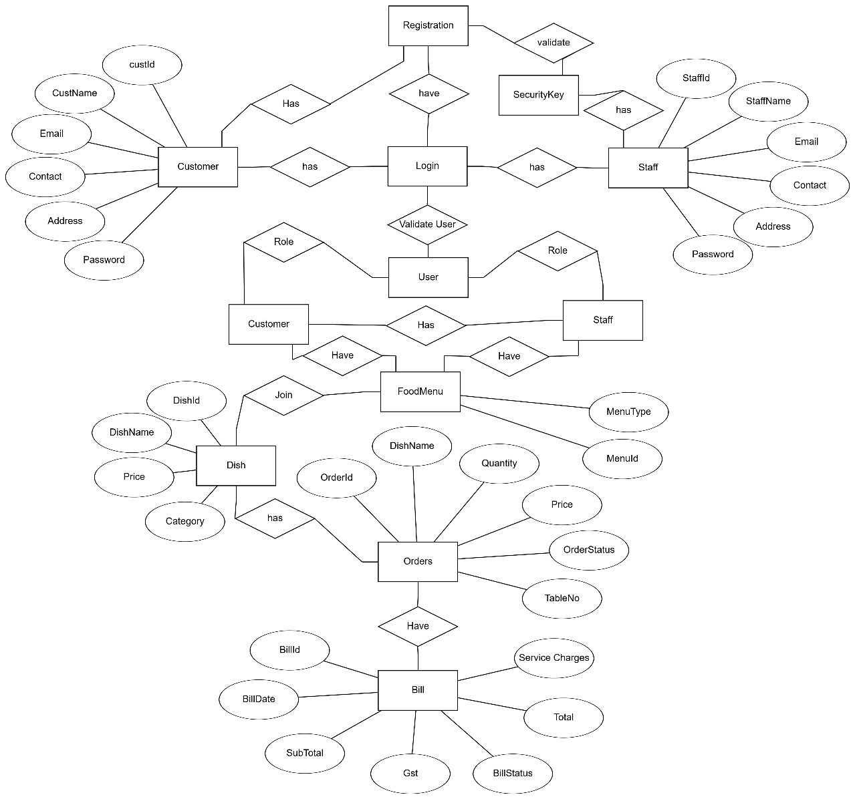
ER DIAGRAM

Slide 9
DATABASE
Usermaster
Login
UserID | int | PRI auto-in
Username | varchar
email | varchar | uni
contact | varchar | uni
address | varchar
password | varchar
role | varchar
LoginId | int | PRI auto-In
Email | varchar | uni
Password | varchar
role | varchar
Dishmaster
Menumaster
dishID | int | Pri auto-in
dishname | varchar | uni
price | int
category | varchar
menuId | int | pri auti-in
menutype | varchar | uni

Slide 10
DATABASE
Tablemaster
Bill
tableNo | int | Pri, check
custID | int | fore
Status | int | Def(0)
billId | Int | Pri auto-in
orderId | int | Fore
billDate | date
subTotal | decimal(10,2)
Gst | decimal(10,2)
serviceCharges | decimal(10,2)
TotalBill | Decimal(10,2)
billstatus | Varchar | Default(Unpaid )
Ordermaster
ordId | int | pri auto-in
dishname | varchar
Quantity | int
Price | int
tableno | int | fore
orderStatus | varchar | Default(pending)
MenuDishJoin
menuId | int | fore
dishId | int | fore

Slide 11


